Slide 1


Your First Few step in Opensource
Vinod Panicker
Lead Architect , Open source and Emerging Technologies
© 2013 WIPRO LTD | WWW.WIPRO.COM

Slide 2








Vinod Panicker
About me ,
Expert in Open source and Emerging Technologies having 15+ years of software development experience.
  Key focus area and specialization : Engineering productivity tools and solutions, Advanced Data Visualization and Machine Learning.
  Led the software engineering tools development initiative for 6 years
  Co-Creator
    Wipro Accelerator- Design tool
    Wipro Code Checker –Code review tool
    Wipro UT And few more..
  TOGAF certified Enterprise Architect with large scale Enterprise Integration experience.
  Open source researcher ,expertise in code partitioning and open source licensing
Specialist Trainer
  Test Driven Development, Refactoring and Groovy on Grails
Papers
  Distributed Agile and Remote Mentoring -- 2008
Speaker @
  National Conference on Cloud Computing 2013 .
  OSI India ,Bangalore ,2012- Next Generation productivity Tools
  Agile 2008, Toronto ,2008 –Distributed Agile
Patents Filed
  US2010269089:Method and system for generation of reusable design patterns
  US2010275183:Source Code Auditor with a customized Rules Builder

Slide 3
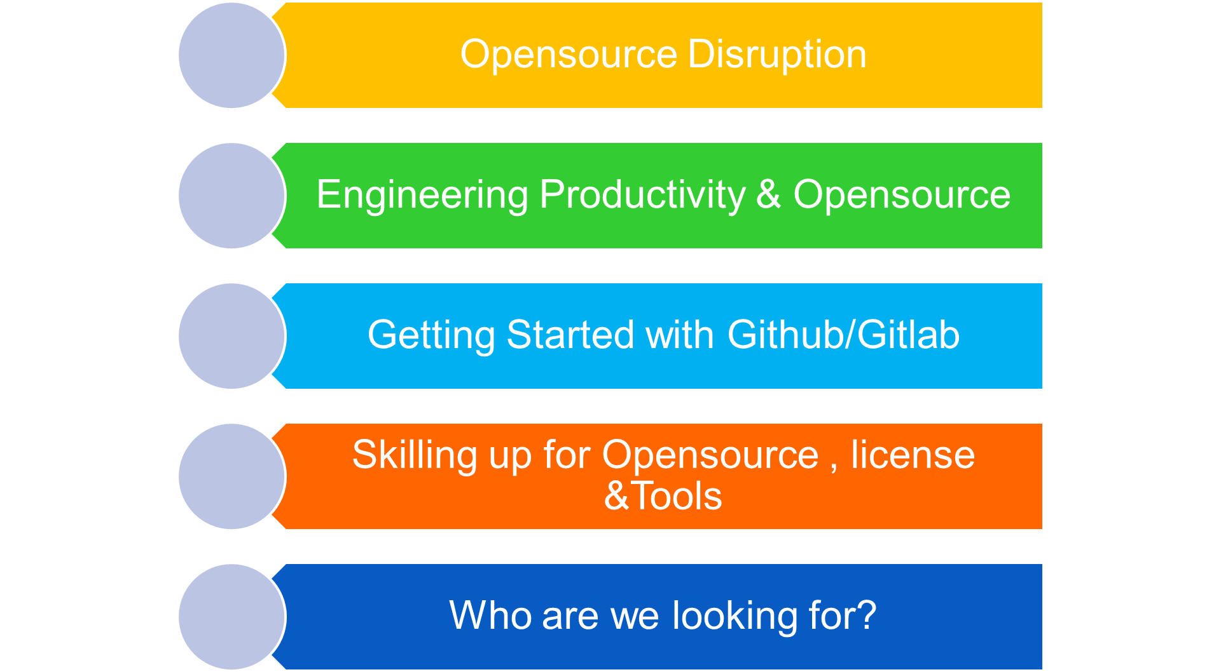
Agenda

Slide 4
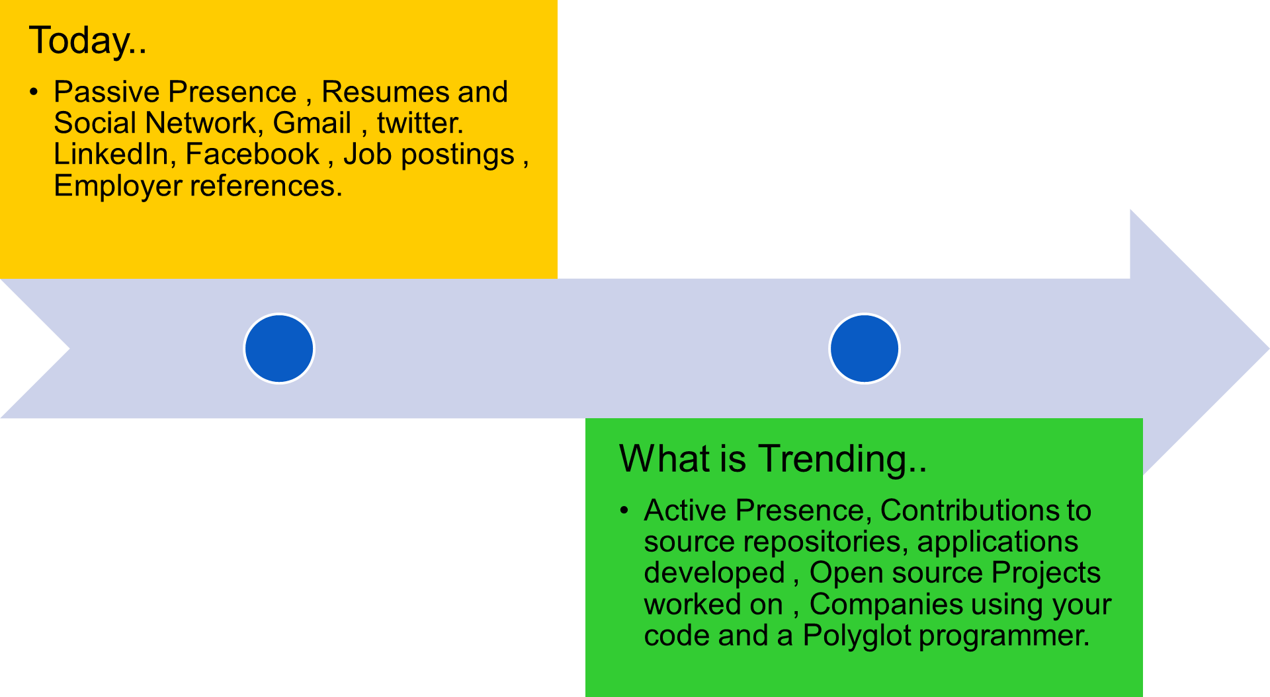





Active/Passive Presence
© 2012 WIPRO LTD | WWW.WIPRO.COM

Slide 5
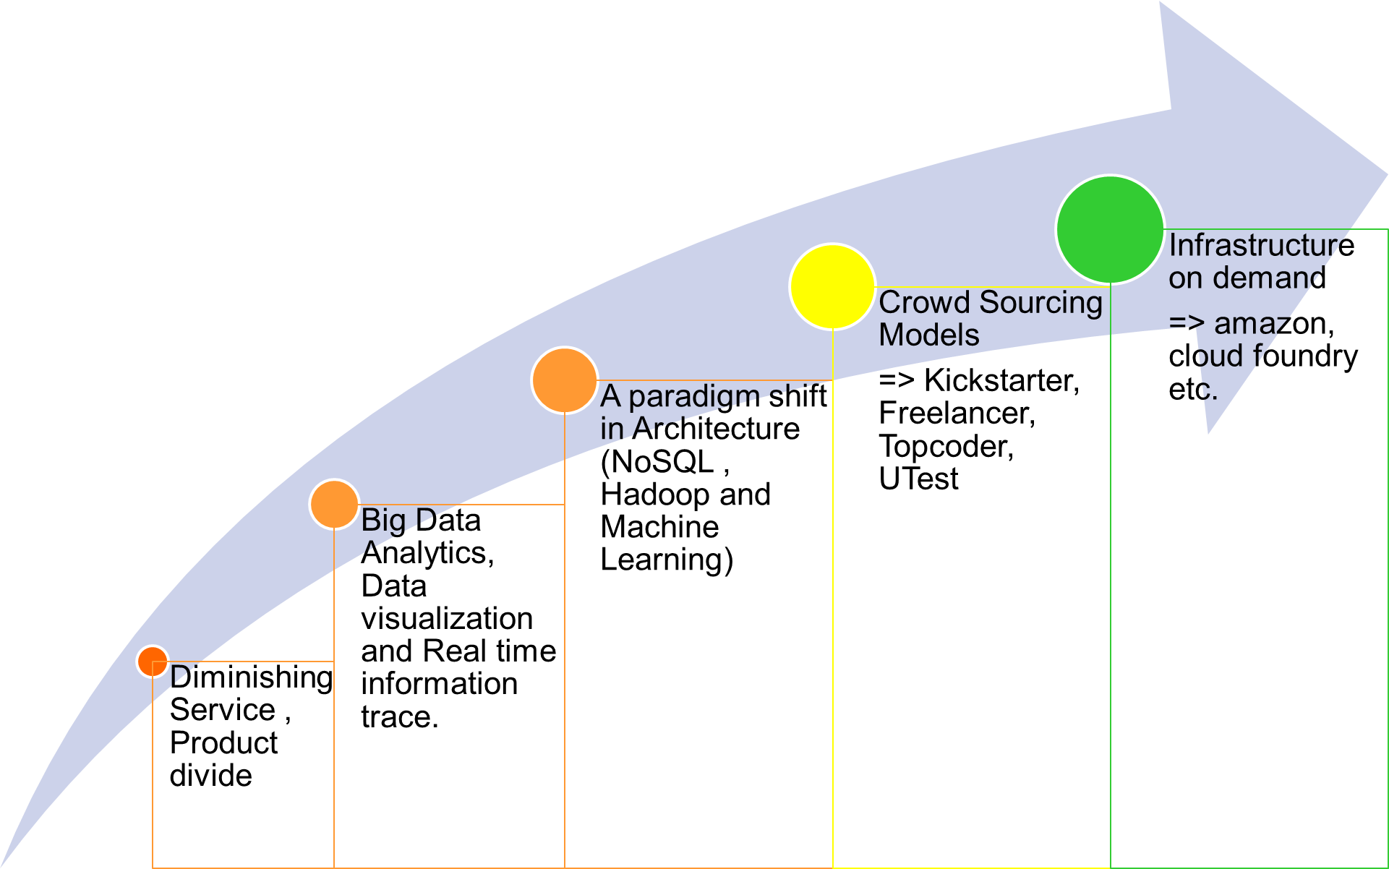







Opensource and “The Disruption”
Simplified IT
© 2013 WIPRO LTD | WWW.WIPRO.COM

Slide 6
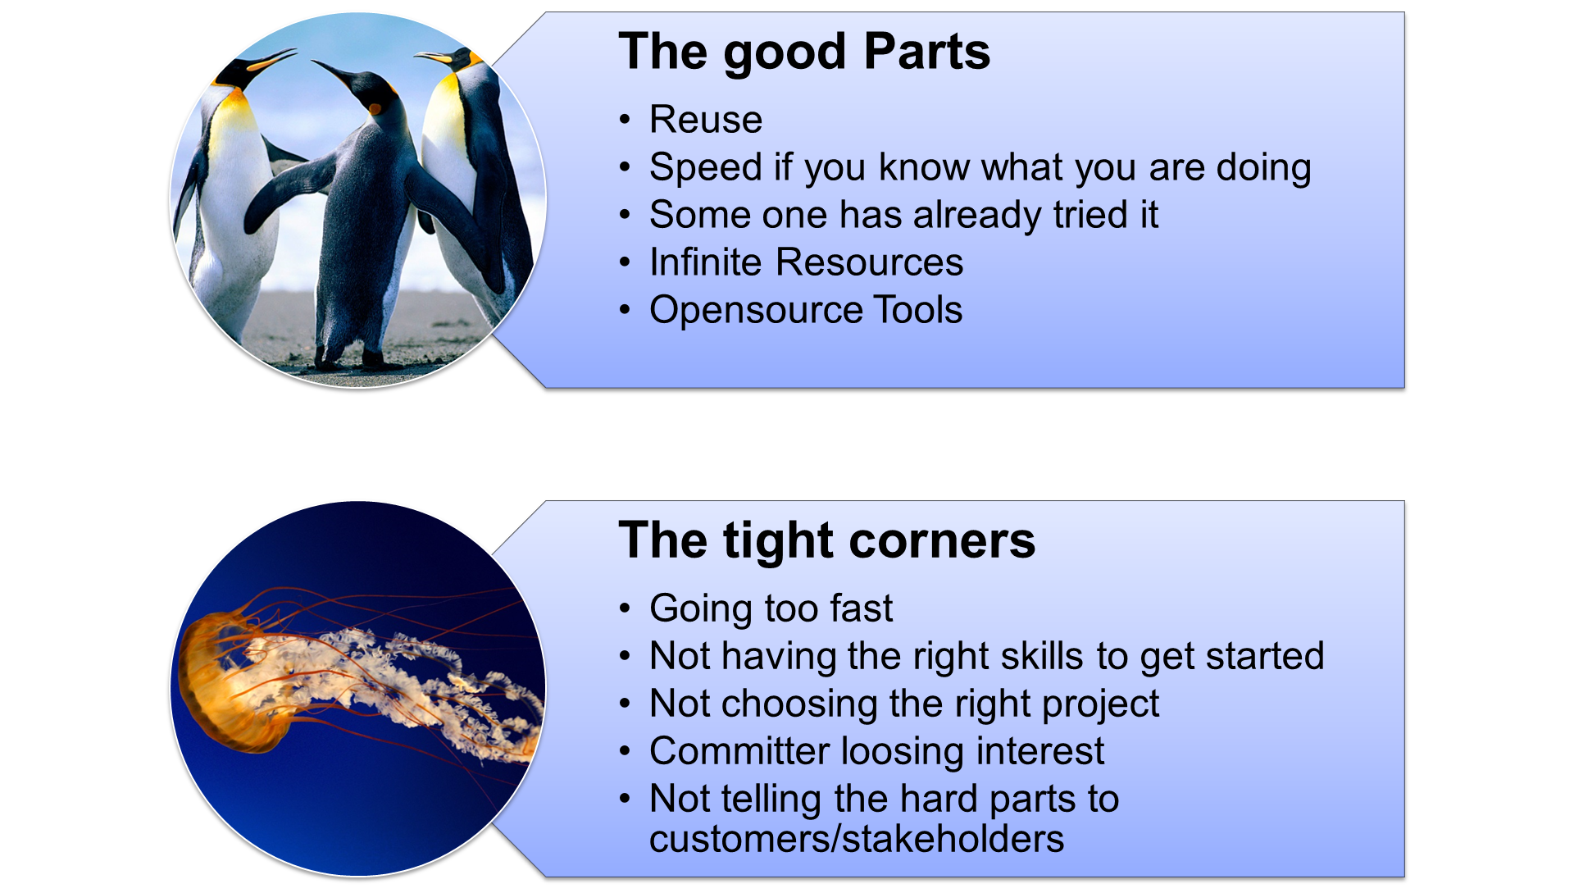
Engineering Productivity & Opensource

Slide 7
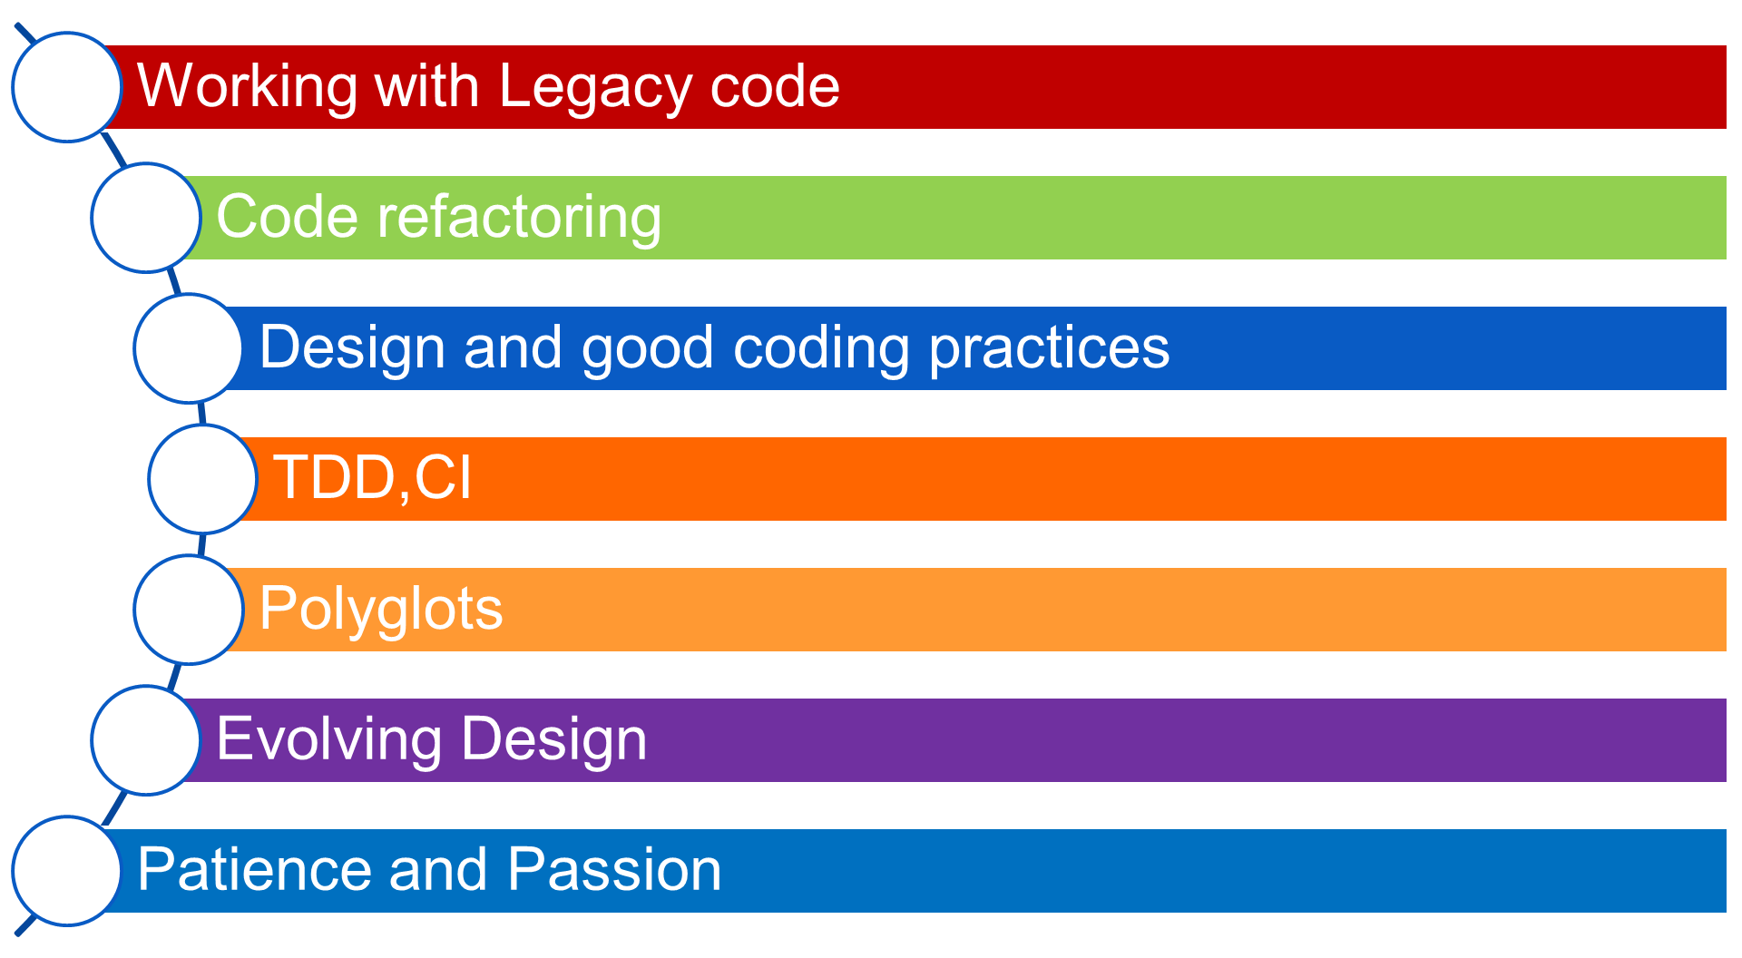
Skilling up for opensource

Slide 8

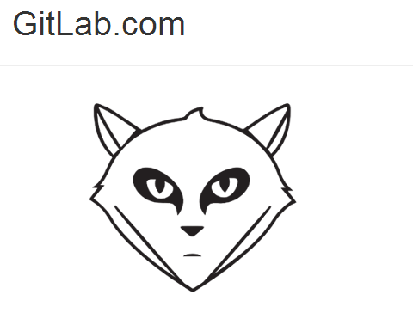
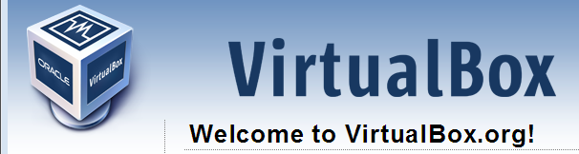
Some fun with Opensource
Visit http://github.com
Create a Github account
Identify a repository & Fork it
Clone locally & Make your changes
Add & Commit
Push to Gitlab*
Create a pull request
Be Patient & answer reviews
Merge & support your patch
Answer issues
You are no longer an opensource newbie… now.
* For gitlab visit http://osggitlab.wipro.com
Notes:
http://www.vogella.com/tutorials/Git/article.html
git remote add origin https://github.com/panickervinod/k1demo.git
git push -u origin master
Jsfiddle.net

Slide 9
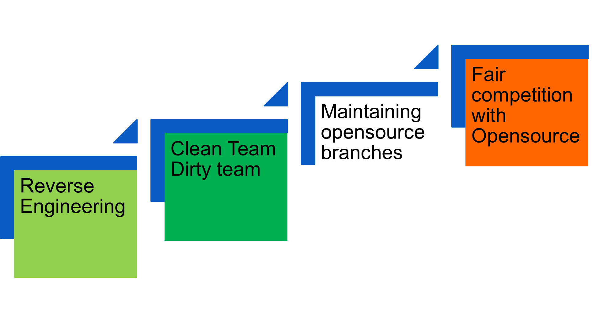
Opensource Project Strategies

Slide 10
Opensource license &Tools
http://opensource.org/licenses
Must visit : http://opensource.org/faq
http://opensource.org/advocacy/case_for_business.php
Blackduck , fossology and similar copyright validation tools
Blackduck’s openhub :
    http://code.openhub.net/search?s=Search%20open%20source%20code
Fossology :
    www.fossology.org/

Slide 11
Who are we looking for?
Join the Opensource community and
Contribute to..
Website
Code
Documentation
Bug Triage
Support Projects & Organize Meet-ups
Give a Talk in a Meetup
As..
Community Members,
Community managers
&Contributors

Slide 12
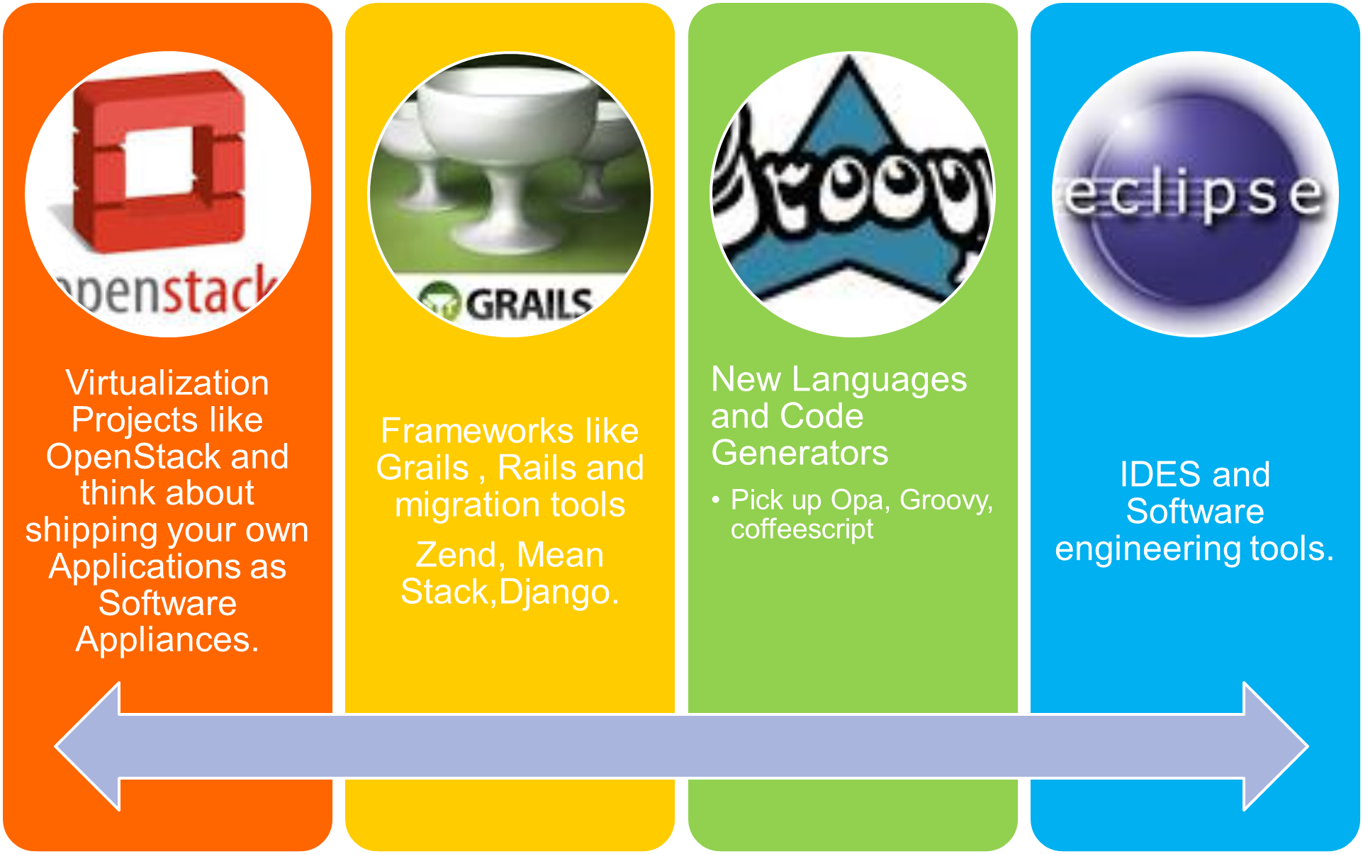
Some projects to start contributing
© 2013 WIPRO LTD | WWW.WIPRO.COM

Slide 13
Summary
  Next Gen applications will be cloud aware and leverage opensource and related technologies to make software and solutions
  Smart
  Adaptive
  Scalable
  Accessible .
  In doing so enable developers and organizations to shift from a passive to an active presence in the software ecosystem.
  Writing code is never going to be the same again. Organization and software professional must be prepared and geared to cease the abundant opportunities opensource will unleash.
  Contributing to opensource is a small step in the right direction..
© 2013 WIPRO LTD | WWW.WIPRO.COM

Slide 14
Thank you
Vinod Panicker
Lead Architect, Open source and emerging Technologies
© 2013 WIPRO LTD | WWW.WIPRO.COM
Notes:
Thank you slide:
Thank you– font size 30, Arial Bold
Name & Designation – font size 18, Arial normal
Your/contact email id – font size 18, Arial normal

